Slide 1
Self-Driving Vehicle Control Modeling using Python & PID
By: Yusuf Wong
Notes:
So last year, I took a course on coursera called Introduction to Self-Driving Cars (sponsored by the University of Toronto), and for the Final project, I given the opportunity to basically implement some autonomous driving Control Modeling methods using Python & PID Control

Slide 2
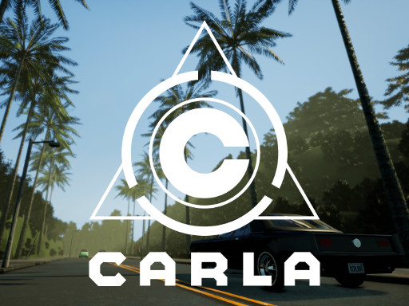
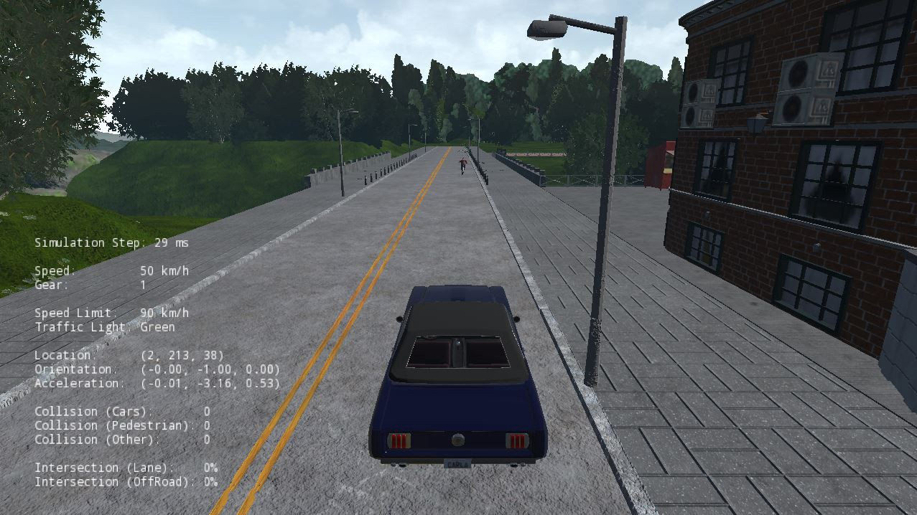
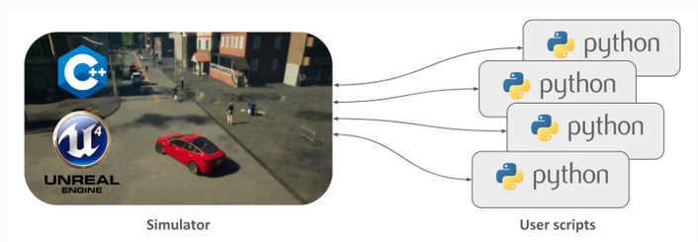
Background
CARLA
Open-source Autonomous Driving Simulator
Utilizes Unreal Engine to run Simulation
Democratizes Autonomous Driving R&D
Modular & Flexible API for Vehicle Control using Python & C++
Scalable Client-Server Architecture
Notes:
To start off, a little background. In order to do this project, I had to use a Software called Carla which is basically an open source autonomous driving simulator. It’s an API for Vehicle control, so by using Python, I can communicate the car’s movements and interactions within the simulation. It’s like a client-server architecture where I’m sending commands from the Python Client into the Carla Server to drive a car on virtual roads and racetracks. This CARLA software is open-source and free for everyone to download and use, making it fair for everyone to test their code on this free simulator.

Slide 3
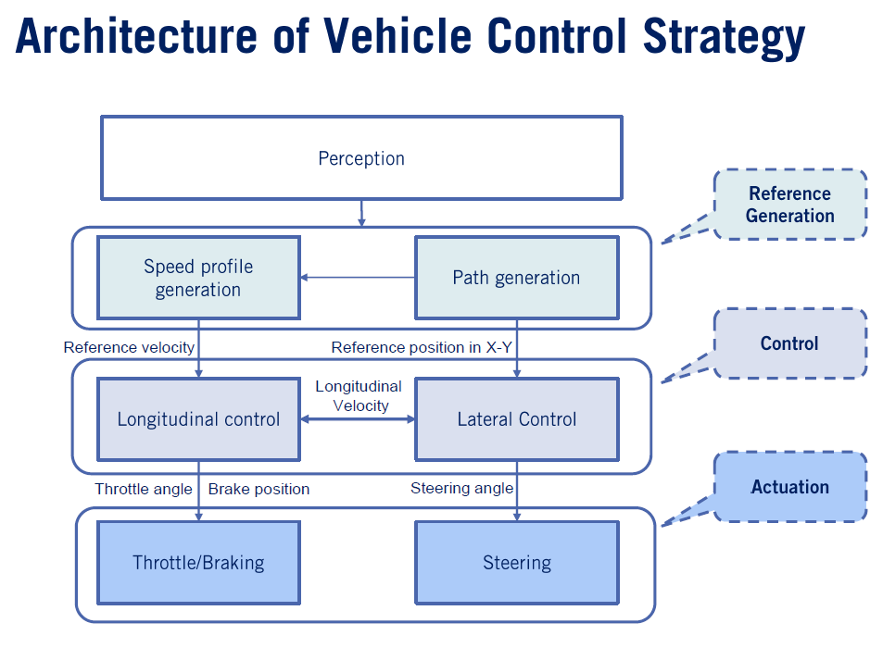
Objectives
Program Driving Simulation using
Python
Vehicle Control Modelling Strategies
Implement PID Control Methods
Longitudinal Control (Throttle/Braking)
Lateral Control (Steering)
Utilized Python & CARLA Simulation Cohesively
Control vehicle to follow race track
Navigate through preset waypoints along predefined path (think Google Maps!)
Receive information of relative position & velocity
Update/Command steering angle & throttle/velocity profiles from Python to CARLA
Adjust Steering Angle & Speed Profiles as Needed
Must reach waypoints at certain desired speeds
Notes:
So the purpose of this project is to implement a controller to automatically allow a vehicle to follow a race track while navigating through preset waypoint using Python & Vehicle Control Modelling Strategies. Think of it like Google Maps where you have a starting point and an ending destination, and you want to automatically control vehicle to reach your destination while still abiding speed limits & roadway rules. For the sake of simplicity, this course has given me the waypoints that specifies both the path and the recommended velocity profile, and I had to use Python to basically utilize this information to implement both lateral & longitudinal control - for both steering and throttling/acceleration/braking

Slide 4
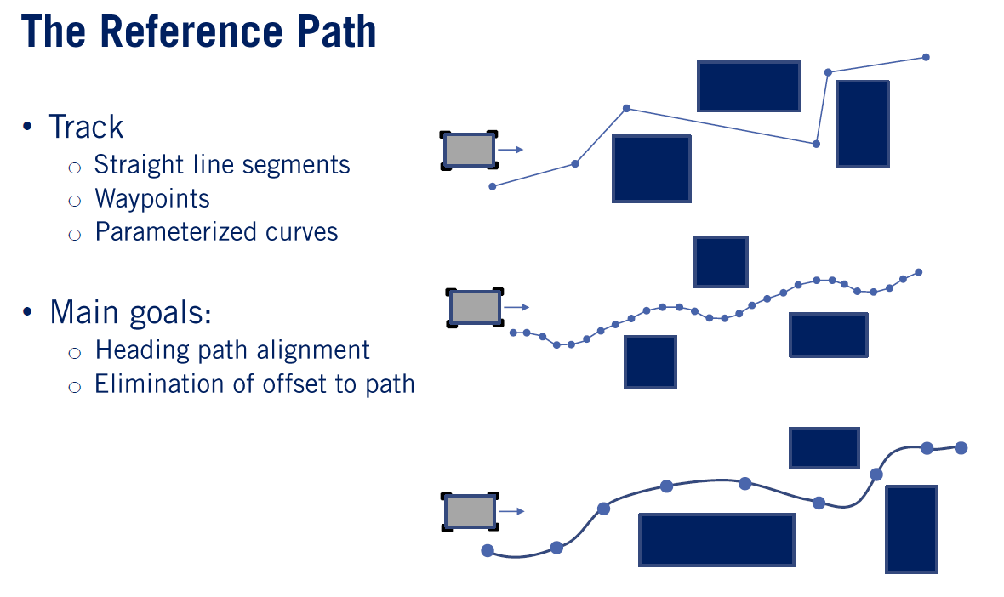
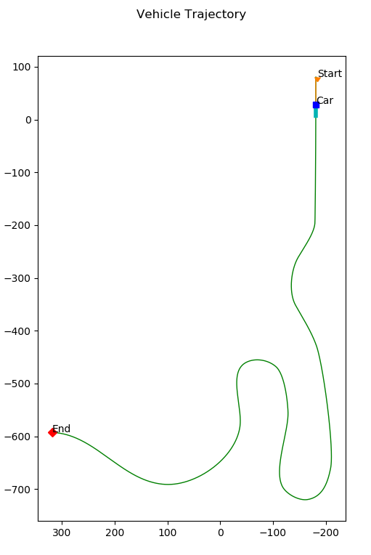
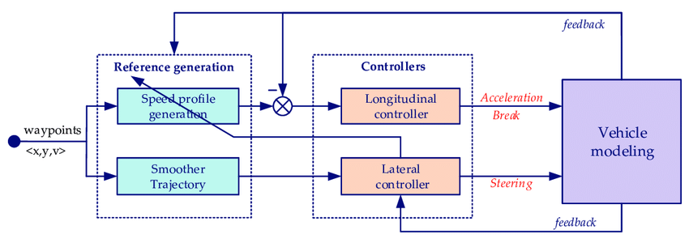
Objectives contd.
Notes:
So here’s basically a layout of what I had to accomplish. Again, I have both a starting and ending point with a recommended reference path, and I had to use both lateral & longitudinal vehicle control modeling methods to control both the acceleration and steering of a car on a virtual racetrack, making sure I don’t go out of bounds.

Slide 5
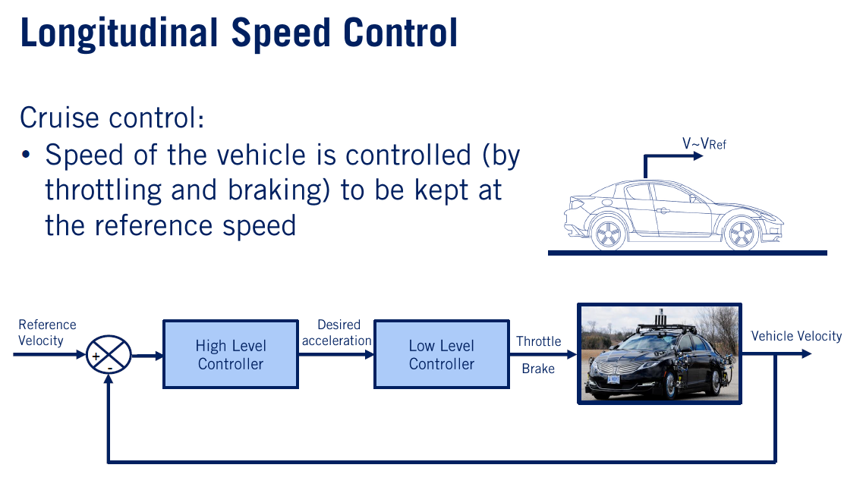
Longitudinal Control (Throttle)
Notes:
In order to control the acceleration of the car, I used longitudinal control modeling method that uses the vehicle’s current velocity and the desired velocity at a specific waypoint to control the amount of actuation of the throttle to either increase or decrease the current speed of the car to match the desired speed at that waypoint.

Slide 6
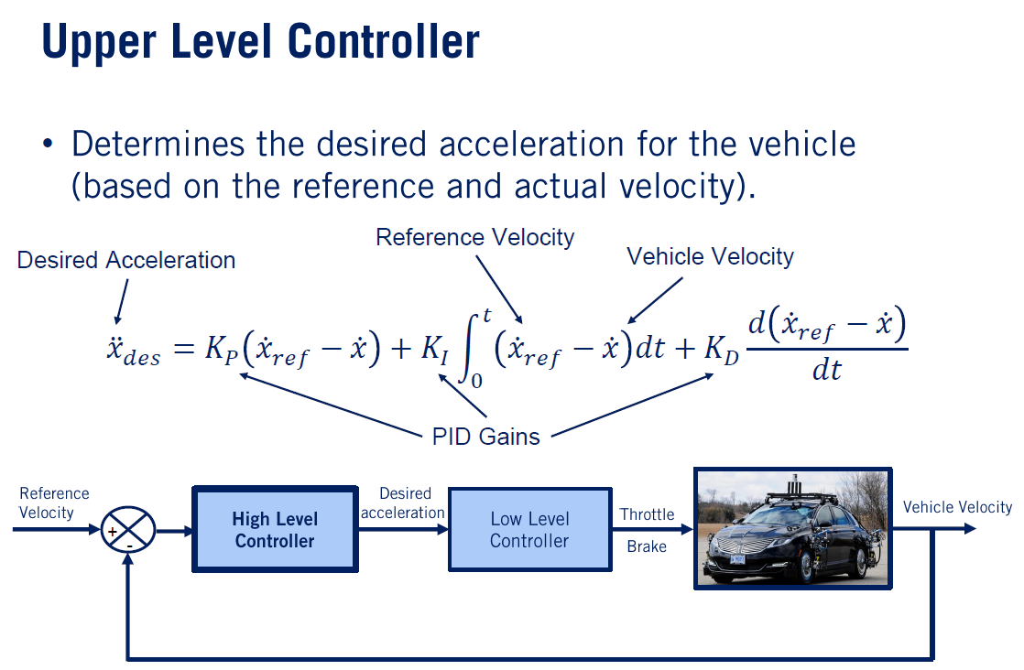
Longitudinal Control (Throttle) contd.
Notes:
To do this, PID Control was used, where I took the proportional, integral, and derivative differences of the desired velocity from the vehicle’s current velocity to either increase or decrease the current throttle or acceleration of the vehicle. For reach of these terms, the K-p, K-i, & K-d were tuned so that the actual velocity of the car matches the desired velocity as quickly and accurately as possible.
Note: Proportional Value/Gain is just the difference of the current velocity from the target velocity Integral Value is the sum of all these discretized differences between each timestep, which is why there’s an integral for this term
Differential value is the derivative or the change in velocity difference

Slide 7
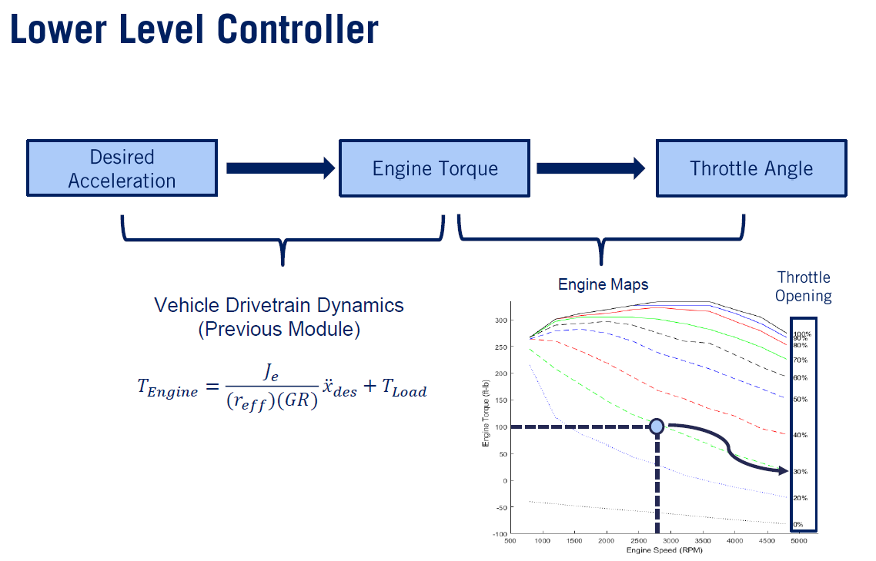
Longitudinal Control (Throttle) contd.
Notes:
Additionally, one can also implement the lower level part of longitudinal control by taking into account the current engine speed of the vehicle to match the throttle percentage opening output. But for the sake of simplicity for this project, this part wasn’t needed.

Slide 8
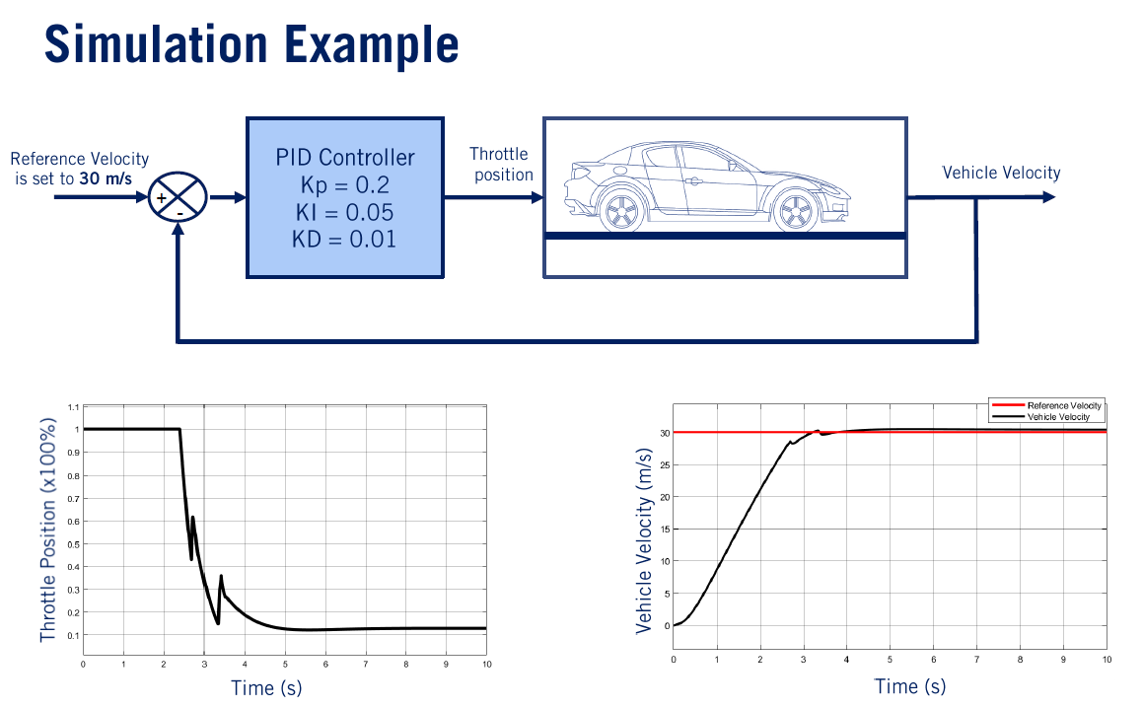
Longitudinal Control (Throttle) contd.
Notes:
Here’s an Example of a car having positive throttle/acceleration for the first 3-4 seconds to go from 0 to 30 m/s. Once the vehicle’s velocity reaches its steady state of 30 m/s, the throttle is very minimal (almost zero). The PID K-p, K-i, & K-d values were altered so that the vehicle reaches its target velocity as quickly and accurately as possible.

Slide 9
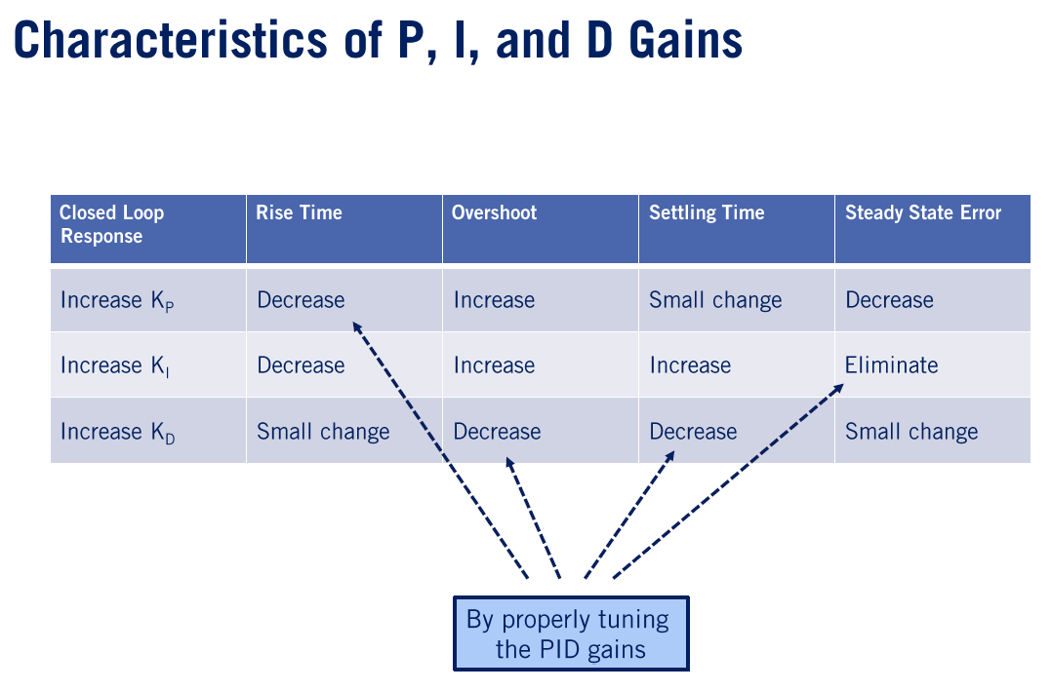
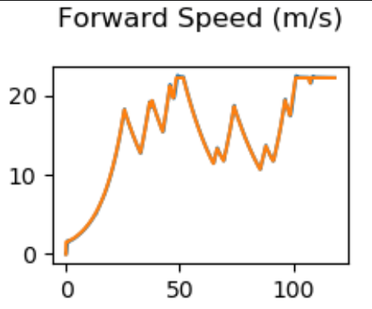
Longitudinal Control (Throttle) contd.
Notes:
Here are just some characteristics of tuning the K-p, K-i, & K-d values w.r.t the speed of the car reaching its target velocity.

Slide 10
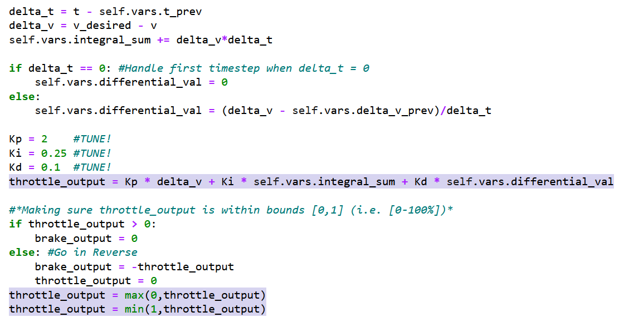
Longitudinal Control (Throttle) contd.
Notes:
Here is part of my code that I used to mathematically implement longitudinal control for the throttle output, making sure that the throttle is within bounds of 0 to 100%, and to go in the reverse direction if ever needed.

Slide 11
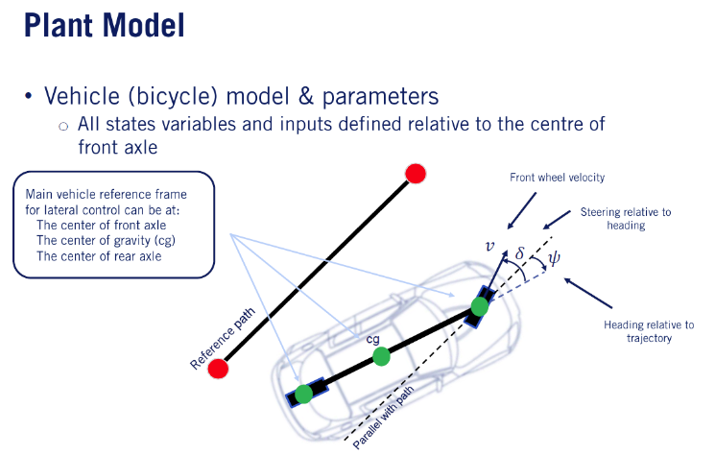
Lateral Control (Steering) using Vehicle (Bicycle) Model
Stanley Lateral Control Model
Steering Angle output of Vehicle
Modified by Two Types of Errors
Heading Error
Crosstrack Error
Notes:
Besides controlling the acceleration of the vehicle, lateral control was also needed to control the steering of the car. Because the waypoints are given, we can use the Bicycle Model to control the direction of the vehicle so that it CLOSELY follows the given reference path. To steer the car into the proper direction, there are two types of errors to consider:
-Heading Error, which is the angular difference between the vehicle’’s current steering angle to the desired reference angle (which is basically the same direction as the current reference path)
-Crosstrack Error, which is the amount of erroneous distance from the center of the axle of the vehicle to the closest point on the path, also known as the perpendicular distance

Slide 12
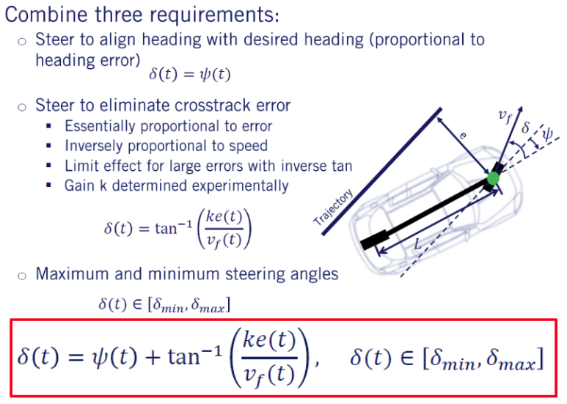
Lateral Control (Steering) using Vehicle (Bicycle) Model
◀ Heading Angle
Crosstrack Angle
▶
Notes:
By combining both heading and crosstrack Errors, we get heading and crosstrack angles, that when we superimpose both angles, we get the desired steering angle to match the desired trajectory from the given waypoints. Note that we make sure that the amount of steering is within a certain range. For this project, we also want to make sure that the angle output is between -1.22 to 1.22 rad/s.

Slide 13
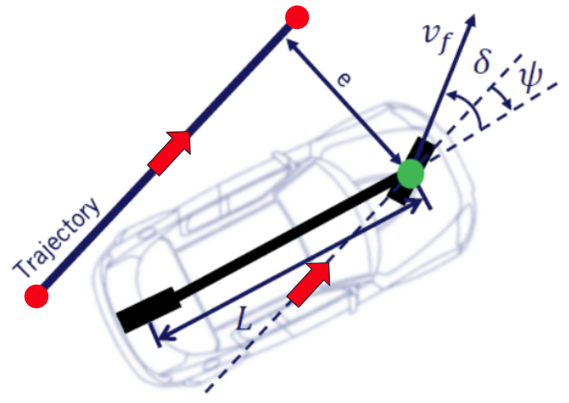
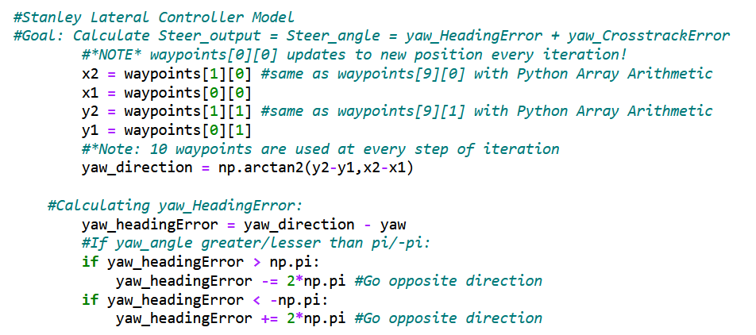
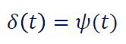
Lateral Control (Steering) contd. - Heading Error/Angle
Notes:
To calculate the heading error, I took the difference of the heading direction vector angle from the vehicle’s current steering angle, giving me the resultant heading angle. Again, because the waypoints are give, I can calculate the vector’s angle w.r.t the vehicle by taking the inverse tangent of the difference in both x & y coordinates of the waypoints.
Note: If the magnitude of the heading error (either positive or negative) was greater than pi, 2-pi was either added or subtracted (since it doesn’t make sense for a wheel to turn more than 180 degs)

Slide 14
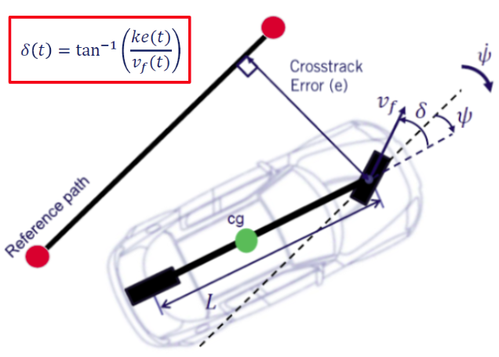
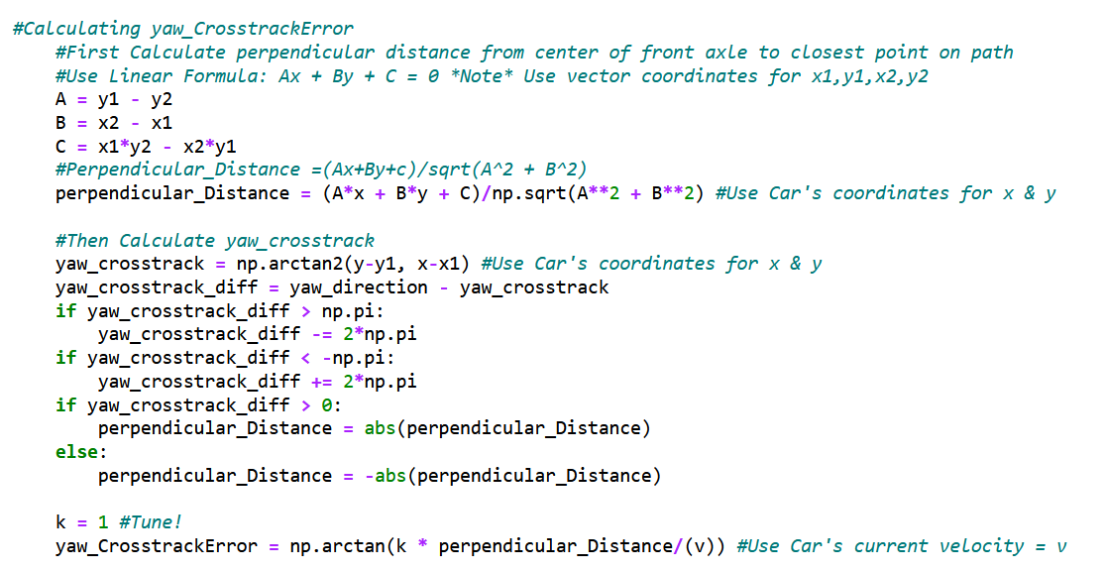
Lateral Control (Steering) contd. - Crosstrack Error/Angle
Notes:
To calculate the crosstrack error, I first calculated the perpendicular distance from the center of the front axle to the reference path determined by the 2 closest waypoints. Then by using the car’s current x & y coordinates, I determined if the perpendicular distance should be either positive or negative, then used the inverse tangent crosstrack angle error formula.

Slide 15
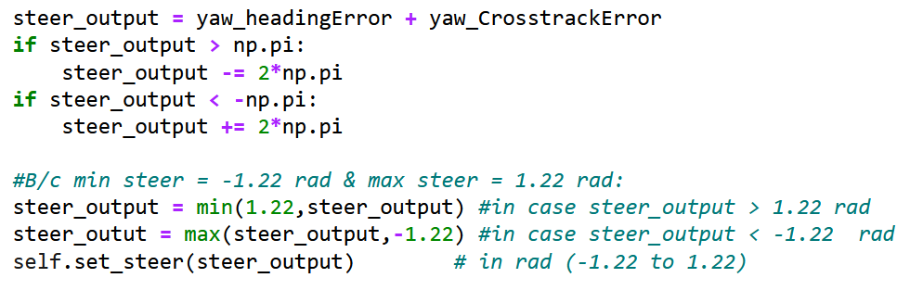
Lateral Control (Steering) contd. - Steer Output
Notes:
Finally, the steering output is determined by summing up both the heading angle (determined by the heading error) & and the crosstrack angle (determined by the crosstrack error).
Note: In order to avoid over/understeering, I made sure that if the steering angle was more than 180deg, that the vehicle turns into the opposite direction, which was why I added either +/- 2pi. Finally, because there are certain physical limits of an actual car, I also made sure that the steering angle was not less than -1.22 rad and not more than 1.22 rad (since it’s really not possible to do a 90deg turn on an actual vehicle

Slide 16
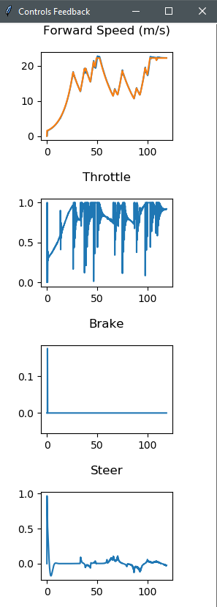

Results - CARLA Driving Simulation!
Notes:
https://www.youtube.com/watch?v=GOaTB2PB0RU

Slide 17
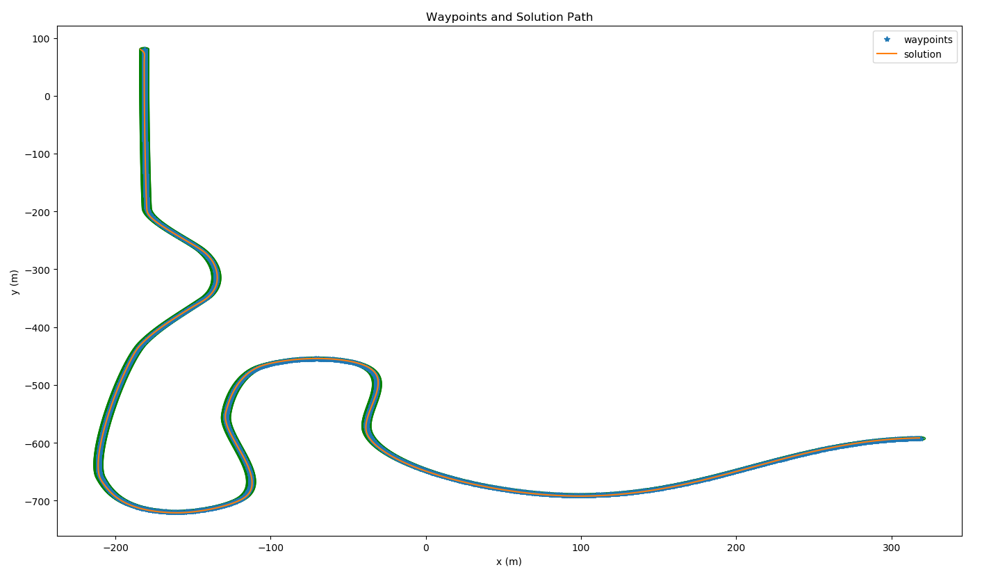
Results - CARLA Driving Simulation!

Slide 18
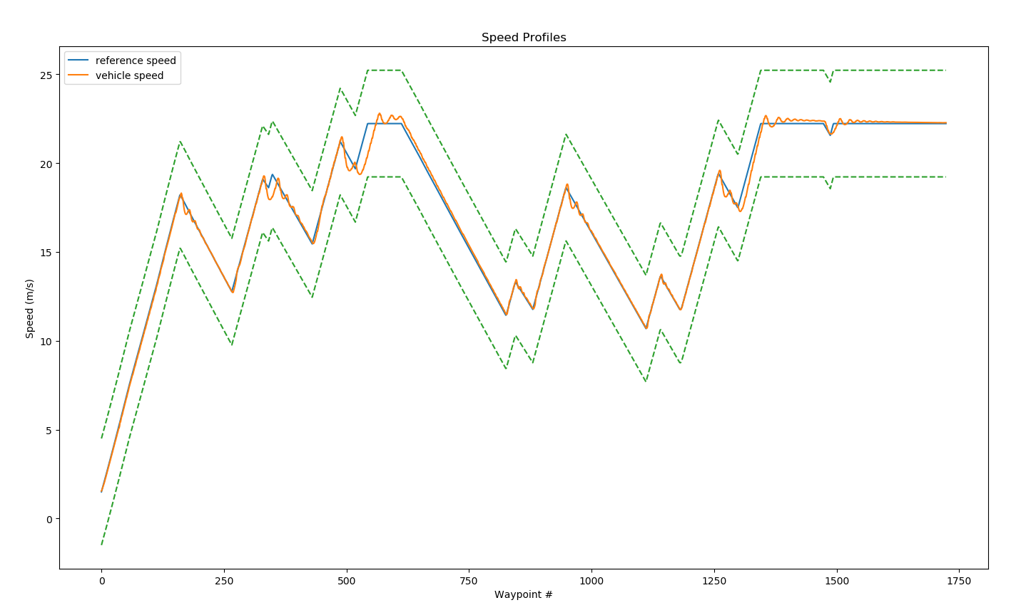
Results - CARLA Driving Simulation!

Slide 19
What I Learned (Reflections)
Vehicle Control Architecture
Client-Server Communication
Sending/Receiving data to/from CARLA Simulator
Utilizing Python libraries to Update Velocity & Steering Profiles
Controlling Vehicle to Follow Racetrack
Vehicle Control Modelling Strategies
Longitudinal Control Modelling (Throttling/Braking)
Lateral Control Modeling (Steering)
PID Control (Tuning)

